Slide 1
Marketing Conversion Analysis: Facebook vs Google AdWords
Data-driven comparison of Advertising platforms
Descriptive Statistics, Hypothesis testing, & Regression Analysis
Objetive: Compare Conversion Performance

Slide 2
Business Context
BrightThreads invests in paid digital advertising across multiple platforms, including Facebook and Google AdWords.
Management wants to identify which platform generates a higher number of conversions in order to optimize future marketing budget allocation and improve return on investment (ROI).

Slide 3
Descriptive Statistics – Ad Clicks
Ad clicks are centered around 60 clicks per campaign, indicating stable engagement levels.
Mean: 60.38
Median: 60
Mode: 78

Slide 4
Descriptive Statistics – AdWords Conversions
AdWords campaigns generate approximately 6 conversions on average.
Mean: 5.98
Median: 6
Mode: 5

Slide 5
Standard Deviation
Conversions show low variability, indicating consistent campaign performance.
Clicks Standard Deviation: 14,36
Conversions Standard Deviation: 1.62

Slide 6
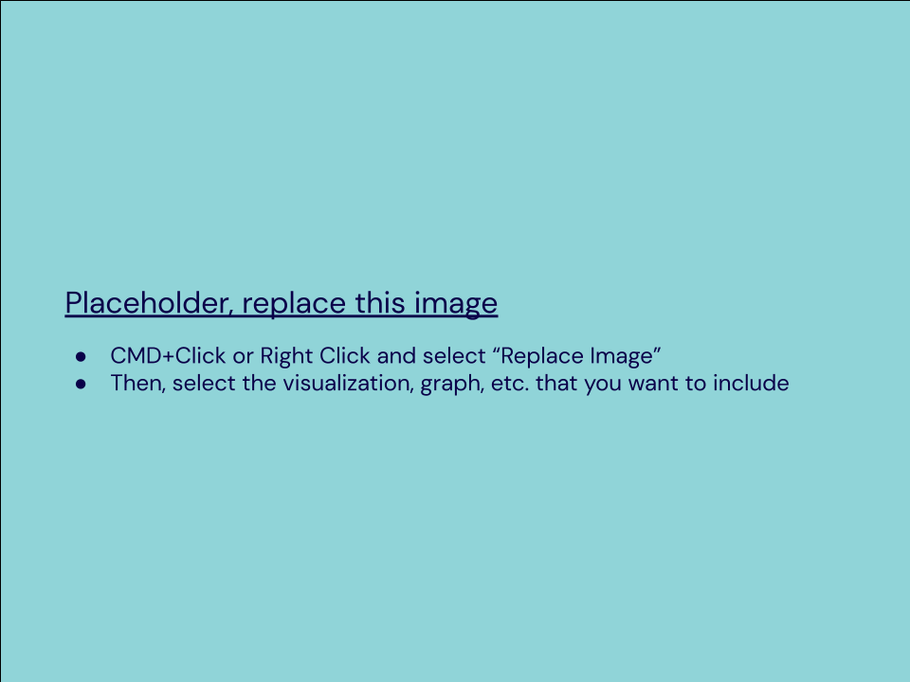
Frequency and Contingency Tables
Most campaigns generate between 6 and 10 conversions, with no extreme high-conversion outliers.
Quantitys | Frequencys
Less than 6 conversions: | 156
6 to 10 conversions: | 209
11 to 15 conversions: | 0
More than 15 conversions: | 0

Slide 7
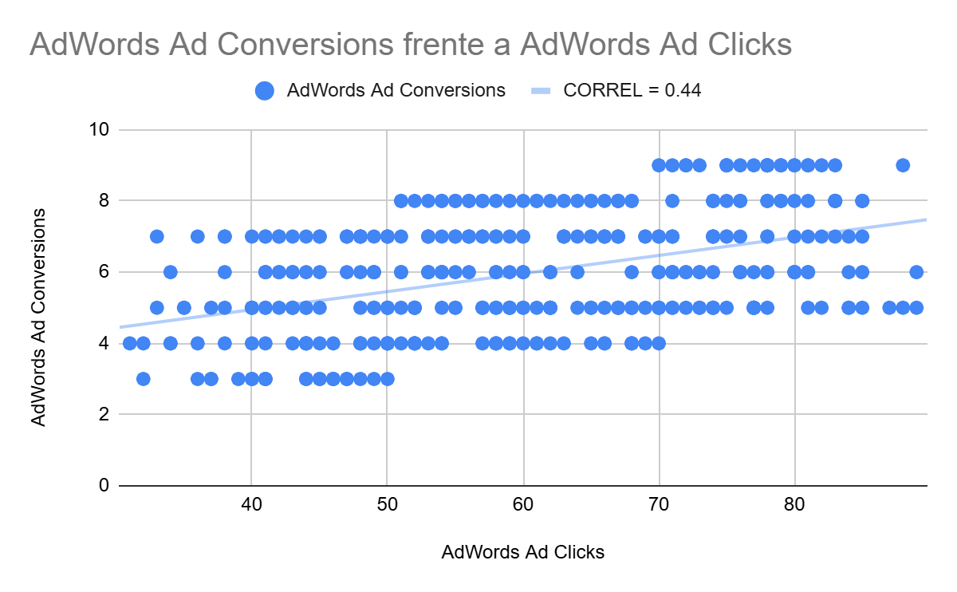
Scatter Plot and Correlation Analysis
There is a moderate positive relationship between clicks and conversions.
An increase in ad clicks generally leads to an increase in conversions.
Correlation coefficient: 0.44

Slide 8
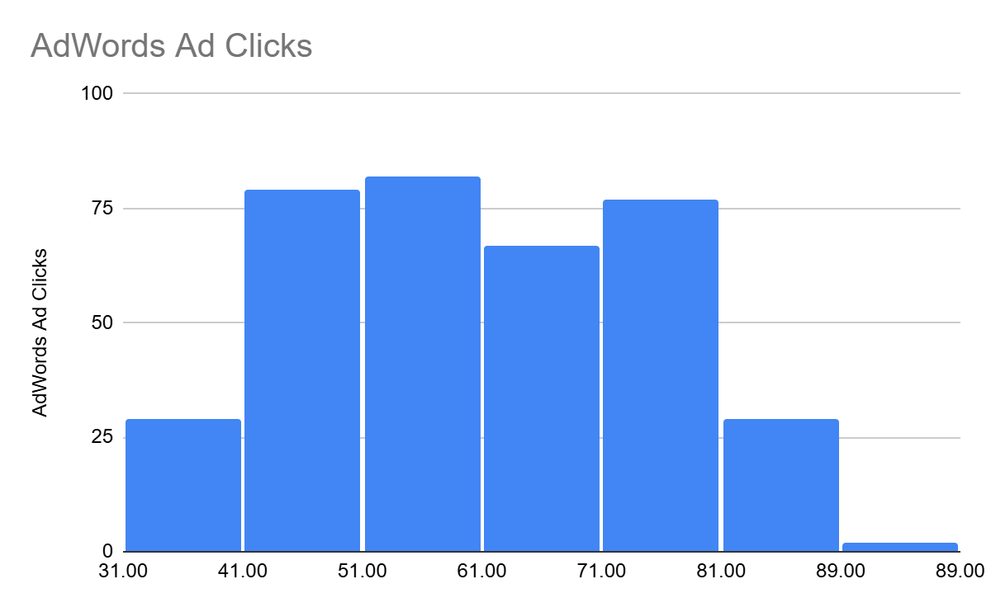
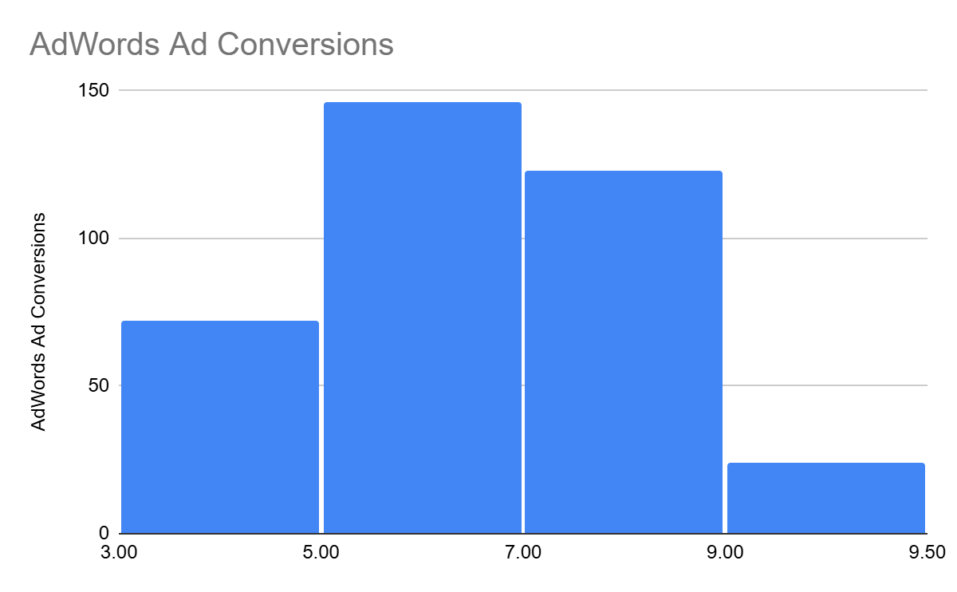
Exploratory Data Analysis
Histograms were created to examine the distribution of clicks and conversions data.
Histogram of clicks data:
Histogram conversions data:

Slide 9
Distribution Assessment
The distributions of both clicks and conversions approximate a normal distribution, making them suitable for parametric statistical testing.

Slide 10
Variable Types
Variable Classification:
Quantitative – Continuous:
AdWords Cost Per Ad, Click-Through Rate (CTR), Cost Per Click (CPC), Conversion Rate
Quantitative – Discrete:
Ad Clicks, Ad Views, Conversions
Qualitative – Nominal:
Advertising Platform
Qualitative – Ordinal:
Not applicable

Slide 11
Research Question and Hypothesis
Research Question:
Is there a difference in the number of conversions between Facebook and AdWords advertising platforms?
Hypothesis:
The number of conversions will be higher on Facebook than on AdWords because Facebook ads reach a more targeted audience.

Slide 12
Variables
Independent Variable:
Advertising platform (Facebook vs AdWords)
Dependent Variable:
Number of conversions

Slide 13
Hypothesis Testing Results
Mean number of Facebook conversions: 11,74
Mean number of Adwords conversions: 5,98
p-Value: < 0.05

Slide 14
Hypothesis Outcome
The results support the alternative hypothesis.
There is a statistically significant difference between Facebook and AdWords conversions, with Facebook showing a higher average number of conversions

Slide 15
Model Selection
The selected model is simple linear regression.
A simple linear regression model was selected to evaluate the relationship between quantitative variables and measure how changes in one variable influence the other.
This model is appropriate because it allows us to evaluate the relationship between two quantitative variables and measure how changes in one variable influence the other.

Slide 16
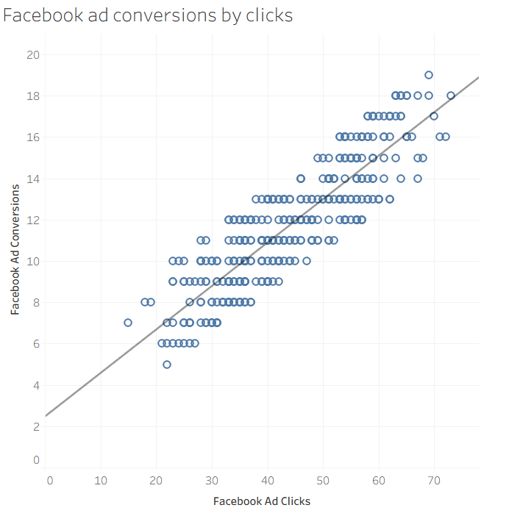
Regression Model
The visualization represents the simple linear regression model used in this analysis, illustrating the relationship between clicks and conversions.

Slide 17
Final Insights
Facebook generates significantly more conversions than AdWords
The difference is statistically significant
Clicks and conversions show a positive relationship

Slide 18
Recommendations
Allocate a greater portion of the advertising budget to Facebook campaigns
Include cost per conversion in future analyses
Segment results by audience type for deeper insights

